Slide 1
Interpretation and interpolation of pixel values - Improvement of image scaling methods
Presented by: Mihir Patil
Under Guidance of :
1st Professor - Prof. Dr. rer. nat. Herbert Litschke
2nd Professor - Prof. Dr.-Ing. Frank Krüger
Presented on: 26/01/2024

Slide 2
Table Of Content
Introduction
Application Of High Resolution Images
Aim Of Master’s Thesis
Image Scaling and Interpolation
Deep Learning
Models based on Deep Learning
Models Implemented
Methods of Evaluation
Evaluation
Conclusion

Slide 3
Introduction
Recovering a High-Resolution(High Resolution (HR)) Image from a Low-Resolution Image (Low Resolution(LR)) is known as Image super-resolution, an essential class of image processing.
Image super-resolution has applications in various domains, such as medical imaging, surveillance, security, and improving other compute.
Image scaling is extensively applied in consumer electronics (e.g., digital cameras, mobile phones, tablets, display devices) and medical imaging, such as computer-assisted surgery and digital radiographs.
To resolve this issue, various Super Resolution (SR) methods have been developed, including traditional approaches like interpolation and regularization, as well as modern techniques based on Convolutional Neural Networks (CNNs).

Slide 4
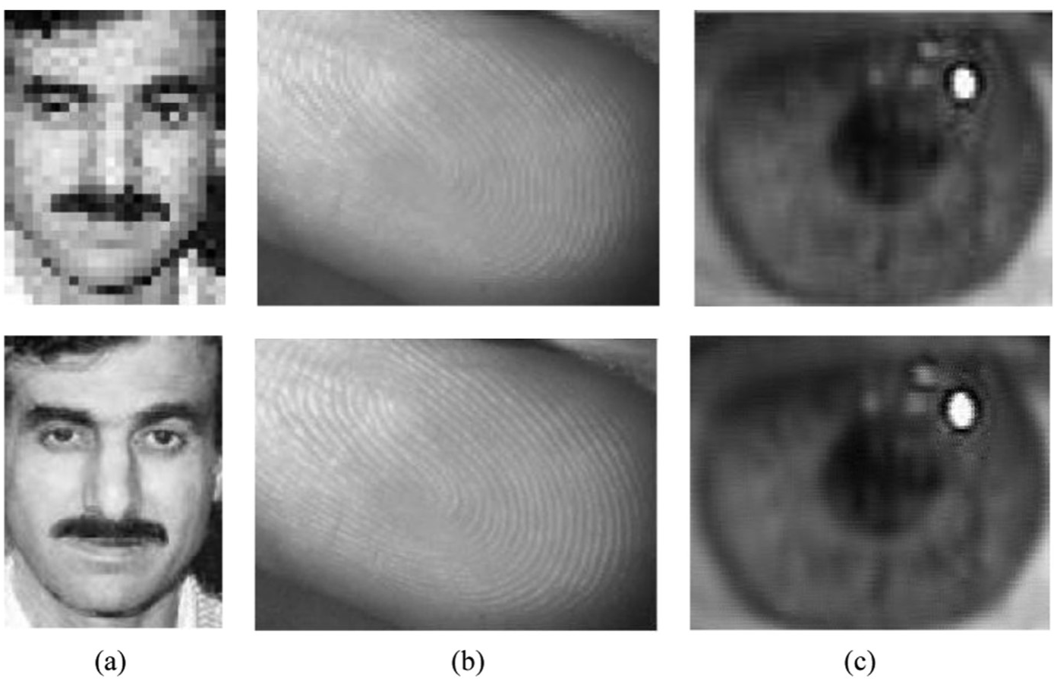
Biometric information identification:
Application Of High Resolution Images
Low-resolution biometric photos are problematic for facial, fingerprint, and iris identification.

Slide 5
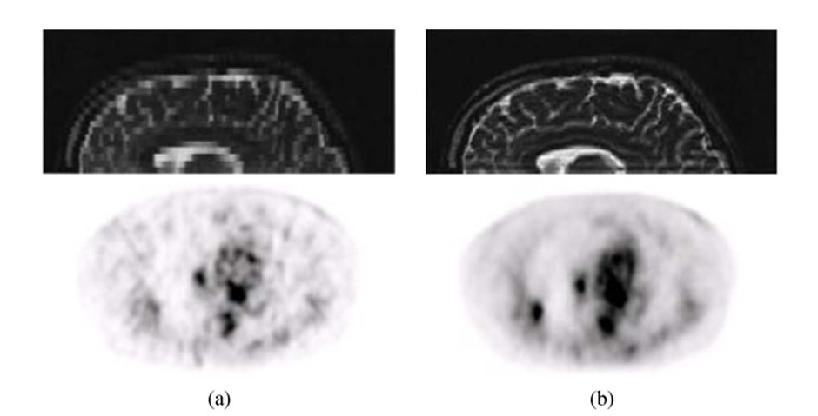
Medical Diagnosis
In field of medical science HR images can be of great help for better diagnose to provide better treatment.

Slide 6
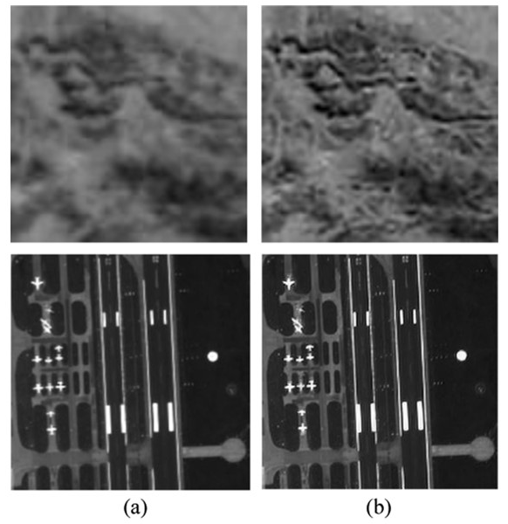
Surveillance and Earth-Observation remote sensing
Digital video recorder (DVR) devices are commonly utilized nowadays and have a big impact on applications like traffic monitoring and security monitoring. However, at this time, equipping large-scale HR devices is not viable

Slide 7
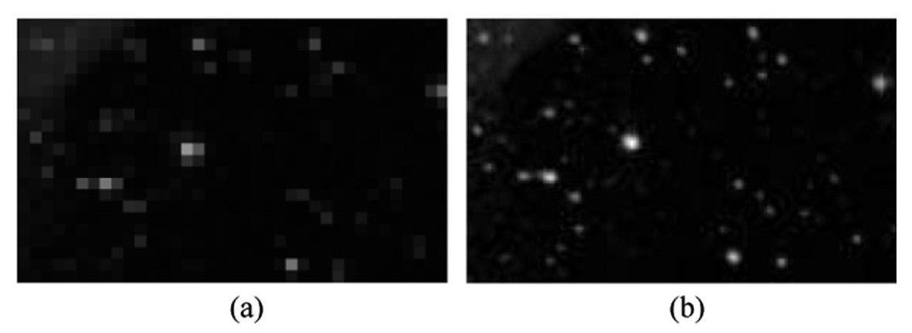
Astronomical observation
HR images can aid astronomers in their exploration of space by increasing the resolution of celestial photographs.

Slide 8
Aim Of Master’s Thesis
This thesis’s primary objective is to comprehensively examine Image Super Resolution (SR) techniques, with a specific emphasis on the comparative analysis of outcomes of both the types of methods which are conventional methods and learning-based approaches.
The evaluation will encompass quantitative measurements, such as Mean Square Error (MSE) and Peak Signal-to-Noise Ratio (PSNR), and qualitative assessments that consider perceptual quality and potential artefacts.

Slide 9
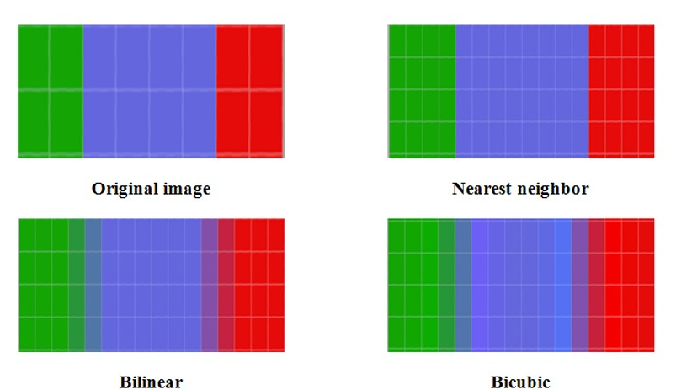
Image Scaling and Interpolation
Image scaling refers to the resizing of a digital image. Interpolation is the process of estimating approximate values from known points to resize image.
Interpolation based methods are as follow:
Nearest Neighborhood Interpolation
Bilinear Image Interpolation
Bicubic Image Interpolation
The above given Interpolation Based methods are also known as non adaptive algorithms, this algorithms apply fixed pattern to each pixel without considering its other parameter as features, or edges of images.

Slide 10
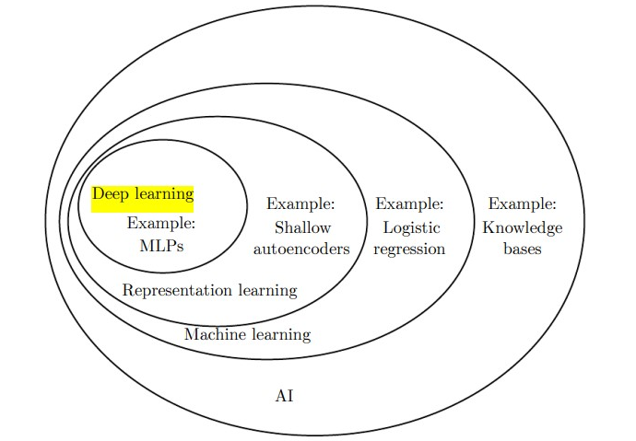
Deep Learning
Deep learning networks learn by discovering intricate structures in the data they experience.By building computational models that are composed of multiple processing layers, the networks can create multiple levels of abstraction to represent the data.

Slide 11
Models based on Deep Learning
Convolutional Neural Network(CNNs)
CNNs are comprised of three types of layers. These are convolutional layers, pooling layers and fully-connected layers. When these layers are stacked, a CNN architecture has been formed.
CNNs are primarily used in the field of pattern recognition within images. This allows us to encode image-specific features into the architecture.
Autoencoder
Autoencoder is a type of neural network where the output layer has the same dimensionality as the input layer
An autoencoder replicates the data from the input to the output in an unsupervised manner and is therefore sometimes referred to as a replicator neural network.
Generative Adversarial Network(GAN)
GANs are a clever way of training a generative model by framing the problem as a supervised learning problem with two sub-models: the generator model that we train to generate new examples, and the discriminator model that tries to classify examples as either real (from the domain) or fake (generated).

Slide 12
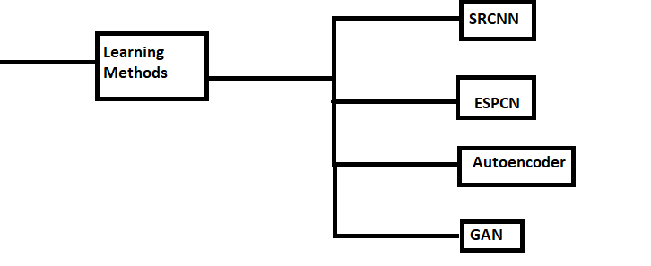
Implementation
Each model was implemented using Python scripts and developed using the Google Colab editor. Colab is a cloud-based platform designed for Jupyter Notebooks, which eliminates the need for any initial setup and provides free access to computing resources, including Graphics Processing Units (GPUs) and Tensor Processing Units (TPUs).
The model has been trained using the DIV2K dataset and evaluated using an 80-20 cross-validation approach.
Implemented Methods are

Slide 13
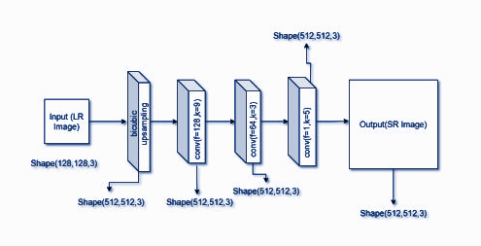
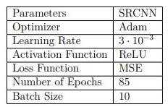
SRCNN (Super-Resolution using Convolution Neural Network)
The model’s hyperparameters are presented in Table, with a total parameter count of 85,889, representing the combined weights and biases within the neural network.
SRCNN consists of 1 upsampling layer at beginning and 3 convolutional layers for extracting features and generate Super Resolution image.

Slide 14
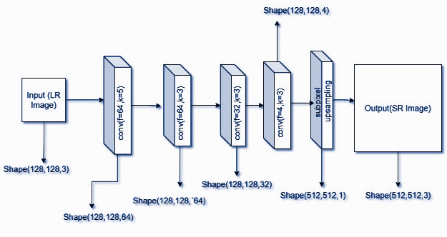
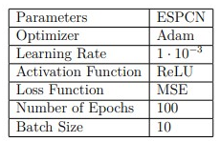
ESPCN (Efficient Subpixel Convolution Network)
The model was trained using the DIV2K dataset and a cross-validation approach with an 80-20 split. The total number of parameters for the 2x scale is 96,740, while for the 4x scale it is 61,680.
Compared to SRCNN, ESPCN consists of 4 convolutional layers, followed by a Bicubic Upsampling Layer with a sub-pixel shuffle function.

Slide 15
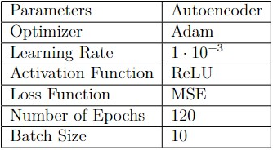
Autoencoders
The model was trained on two different scales (2x and 4x), They have the same algorithm and structure. As mentioned, before it is trained on the DIV2K dataset and 80-20 cross-validation. With total number of parameters for a 2x scale is 1,586,179, and for a 4x scale is 2,029,315

Slide 16
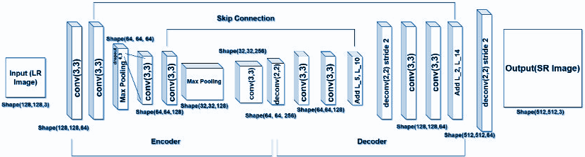
In autoencoder we have 2 systems, 1st is encoder and the second is decoder. The features of the image are extracted and encoded for each image in training dataset. And the mapping is learned by decoding this encoded features to generate a SR Image.

Slide 17
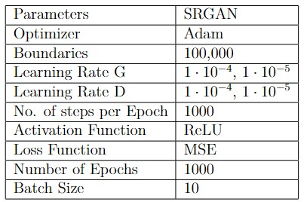
SRGAN (Super-Resolution Generative Adversarial Networks)
Super-Resolution Generative Adversarial Networks (SRGAN) has been implemented using scale 4x. The model is trained on the DIV2K dataset. It is divided into generator and discriminator with a total number of parameters for generator is 1,553,667 and for discriminator is 23,569,217.
A VGG loss is used to improve the MSE loss that often fails to enforce fine SR image generation The following Table contains the hyperparameters of the model.

Slide 18
SRGAN Generator
SRGAN Discriminator
The generator model takes a low-resolution image as input and produces a high-resolution super-resolved image as output. It consists of 16 residual blocks, each containing two convolutional layers with PReLU activations, Batch Normalization, and a skip connection. The model uses pixel shuffle layers for upsampling to the desired scale.
This discriminator is designed to evaluate the authenticity of super-resolved images, helping to train a GAN for image super-resolution.
It assesses whether the input image is more likely to be real (high-resolution) or fake (super-resolved). The LeakyReLU activation functions introduces non-linearity, and batch normalization helps stabilize training.

Slide 19
Objective methods
Methods of Assessments
Mean Square Error (MSE)
The difference between the Pixel value of one image and the corresponding Pixel value of the other image. The MSE measures the average of the square of the errors.
Peak Signal to Noise Ratio(PSNR)
PSNR is used to calculate the ratio between the maximum possible signal power and the power of the distorting noise this ratio is used as a quality measurement between the original and a reconstructed image.
Structure Similarity Index Method (SSIM)
It measures the similarity between two images in 3 aspects (luminance, structure, contrast.
Universal Image Quality(UQI)
It is a reference-based image comparison technique. This method quantifies the image quality by comparing it to a reference image(in our case original image). This method is known to be Universal Image Quality Index (UQI).

Slide 20
Test Dataset
Set5
Introduced by Marco Bevilacqua et al. The Set5 is a dataset consisting of 5 images (“baby”, “bird”, “butterfly”, “head”, “woman”) commonly used for testing performance of Image Super-Resolution models.
Set14
Introduced by Roman Zeyde et al. The Set14 a dataset consisting of 14 images commonly used for testing the performance of Image Super-Resolution models.
Medical Images
Helping Deep Learning and AI Enthusiasts like me to contribute to improving COVID-19 detection using just Chest X-rays. It is a simple directory structure branched into test and train and further branched into the respective 3 classes which contains the images.
Satellite Images
Satellite imagery used to build this dataset is made available through Planet’s Open California dataset, which is openly licensed.

Slide 21
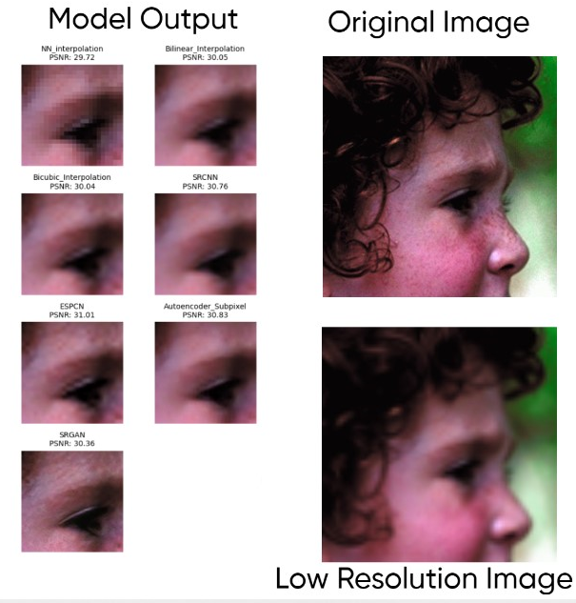
Set5 Dataset Results
Evaluation
The head.png is evaluated and presented.

Slide 22
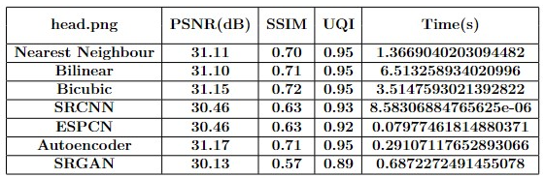
The table provides metrics based evaluation and time required for upscaling the image.

Slide 23
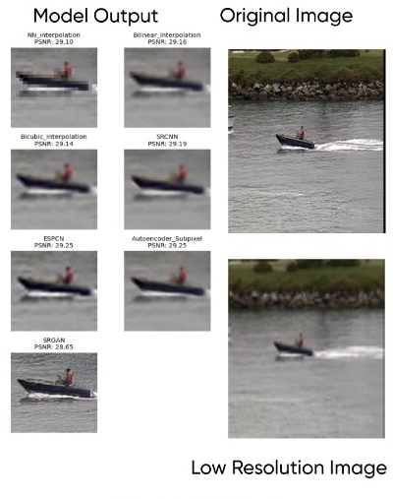
Set14 Dataset Results
The coastguard.png is evaluated and presented.

Slide 24
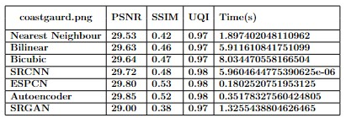
The table provides metrics based evaluation and time required for upscaling the image.

Slide 25
Conclusion
This dissertation provides a detailed introduction to the topic of Image Interpolation and its techniques implementation and compares the results of the implemented models. Further, a detailed comparison of reconstruction results was displayed.
The Autoencoder model has superior performance in terms of metrics evaluation.
The SRCNN model exhibits the most computational efficiency among all the models considered.
Although SRGAN does not demonstrate exceptional performance in conventional metrics such as PSNR, it has remarkable proficiency in generating visually fascinating outcomes characterized by detailed features, textures, and sharpness.

